Slide 1
Smart Irrigation System for Precision Farming
CSE7101- Capstone Project
Review-2
Batch Number:
CSE_159
Roll Number | Student Name
20221CSE0120 | Polisetty Vamsi Bala Kiran
20221CSE0112 | Muvvala Siva Kumar
20221CSE0115 | Narala Pallavi
Under the Supervision of,
Dr.Venkataravana Nayak K
Assistant Professor
School of Computer Science and Engineering,
Presidency University.
Name of the Program: B-Tech(C.S.E)
Name of the HoD: Dr. Asif Mohammed , Dr. Blessed Prince
Name of the Program Project Coordinator: Dr. Jayavadivel Ravi, Mr.Muthuraju V
Name of the School Project Coordinators: Dr. Sampath A K , Dr. Geetha A

Slide 2
Problem Statement Number: PSCS_208
Organization: Presidency University
Category : Hardware and Software
Problem Description:
Traditional irrigation methods waste water and increase costs due to fixed schedules and manual operation. They fail to adapt to real-time soil and environmental conditions, leading to reduced crop yield. The proposed Smart Irrigation System uses IoT sensors, an ESP8266 microcontroller, and the Blynk platform to automate irrigation, optimize water usage, and improve farming efficiency.

Slide 3
Problem Statement:
Current irrigation practices in agriculture often lead to water wastage and inefficiency due to the lack of real-time monitoring and automated control. There is a need for a smart, cost-effective system that can monitor soil and environmental conditions, automate irrigation, and optimize water usage for improved crop productivity.
Objectives:
Monitor soil moisture, temperature, and humidity in real time.
Automate irrigation using IoT-enabled sensors and ESP8266.
Enable remote monitoring and control through the Blynk platform.
Reduce water wastage and improve crop productivity.

Slide 4
Literature Survey
An Intelligent Irrigation Scheduling System Using Low-Cost Wireless Sensor Network Toward Sustainable and Precision Agriculture — IEEE Access, 2020
Smart Irrigation Systems: Overview — IEEE Access, 2023
AgriSens: IoT-Based Dynamic Irrigation Scheduling System for Water Management of Irrigated Crops — IEEE IoT Journal, 2021
Smart Irrigation System for Precision Agriculture—The AREThOU5A IoT Platform — IEEE Sensors Journal, 2021
Towards Precision Agriculture: IoT-Enabled Intelligent Irrigation Systems Using Deep Learning Neural Network — IEEE Sensors Journal, 2021
A Virtual Soil Moisture Sensor for Smart Farming Using Deep Learning — IEEE Trans. on Instrumentation and Measurement, 2022
Fuzzy Logic Controller-Based IoT for Smart Irrigation System — IEEE ICAECA, 2021
Water Management for Sustainable Irrigation Systems Using Internet-of-Things, IEEE Access, 2022
IoT and Machine Learning-Based Smart Soil Irrigation Farming Systems — IEEE conference paper (2024)
Low-Cost Soil Moisture Sensors for Precision Agriculture,” IEEE Sensors Journal, 2020

Slide 5
Background & Related Work:
IoT-based smart farming solutions improve irrigation efficiency through sensor data and automation.
Prior research shows integrating soil moisture, temperature, and humidity sensors with wireless communication reduces water usage and improves yield.
Existing systems often lack scalability, real-time alerts, and adaptive control.
Innovation / Novel Contributions:
Integration of ESP8266 with Blynk IoT for real-time monitoring and control.
Dual operation modes: Automated and Manual override.
Cost-effective, scalable design suitable for small and large farms.
Real-time environmental data processing for optimized irrigation schedules.

Slide 6
Analysis of Problem Statement
Water Wastage in Agriculture:
Traditional irrigation often applies more water than needed, leading to wastage and depletion of water resources.
Manual Operation Challenges: Farmers must manually operate pumps and monitor soil, which is time-consuming and labor-intensive.
Lack of Real-Time Monitoring: Most existing systems cannot adapt to changing soil moisture, temperature, or humidity conditions instantly.
Impact on Crop Yield: Over-irrigation and under-irrigation both harm crop health, reducing productivity and profitability.
Need for Affordable Smart Solutions: Many advanced irrigation systems are costly and inaccessible to small and medium-scale farmers.
Proposed Approach: Implement an IoT-enabled, cost-effective system that uses ESP8266, soil moisture sensors, and the Blynk IoT platform to provide automated irrigation with remote control and monitoring capabilities.

Slide 7
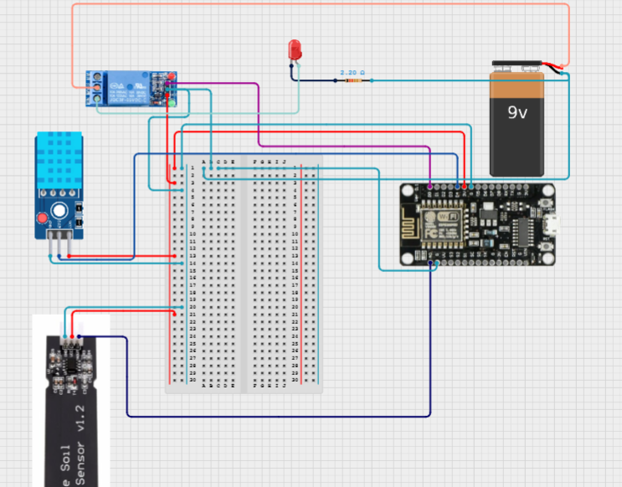
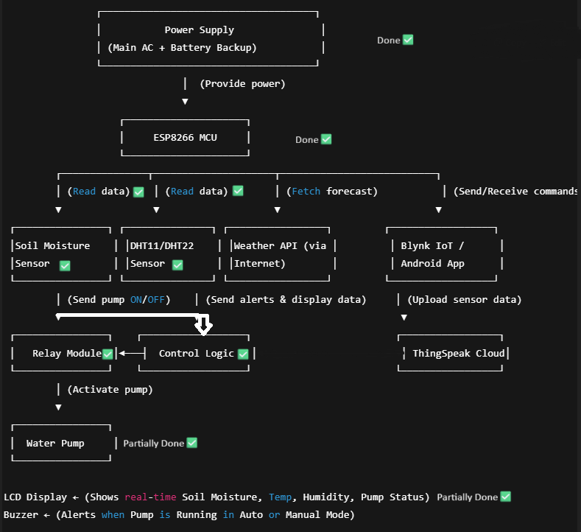

Slide 8
1. Hardware Components (Updated)
ESP8266 Wi-Fi Module – primary microcontroller, IoT + automation logic.
Arduino UNO R3 – backup controller (runs core irrigation logic when ESP8266 fails).
Soil Moisture Sensor – shared via multiplexer / dual input to both ESP & UNO.
DHT11/DHT22 Sensor – shared for temperature & humidity.
Relay Module – shared; driven by ESP normally, but UNO takes over if ESP offline.
Water Pump – controlled via relay.
LCD Display (16×2, I2C preferred) – connected to UNO, with optional data mirroring from ESP.
Power Supply :Primary: AC to DC adapter.
Backup: Rechargeable battery pack.
Power Control Logic – both ESP and UNO powered, but UNO is in standby unless takeover is needed.
Sound Sensor with Buzzer – alerts pump activity (either ESP or UNO).
Failover Switching Logic:
Option A: Use a logic-level MOSFET / multiplexer to switch relay control between ESP & UNO.
Option B: UNO monitors ESP heartbeat signal via serial/TxRx. If ESP stops responding → UNO takes over.

Slide 9
2. Software Stack (Updated)
ESP8266 (Primary System)
Arduino IDE firmware for automation + IoT features (Blynk, ThingSpeak).
Runs advanced features like weather API checks, cloud sync, chatbot integration.
Arduino UNO R3 (Backup System)
Arduino IDE firmware with basic irrigation logic:
Reads soil moisture + DHT sensor.
Activates relay/pump if soil < threshold.
Updates LCD locally.
Minimal — ensures irrigation continues even if ESP fails.
Failover Communication
UNO listens for a “heartbeat” signal from ESP8266 (simple HIGH/LOW pin toggle every fewseconds).
If heartbeat lost → UNO activates its irrigation routine & controls the relay.
If ESP recovers → UNO releases control back to ESP.

Slide 10
3. Modes of Operation (Updated)
Mode 1 – Fully Automated (ESP Active)
Same as before: cloud + weather + smart irrigation.
UNO remains in passive mode, only monitoring ESP heartbeat.
Mode 2 – Fully Manual (ESP Active)
Controlled via Blynk or Android app.
UNO still passive.
Mode 3 – Failover (UNO Active)
Triggered if ESP8266 fails (no heartbeat).
UNO takes over pump control with simple threshold-based automation.
LCD continues showing real-time data.
Buzzer alerts user that the system is in backup mode.
4. Extra Features (New with Dual System)
Dual Microcontroller Redundancy: UNO ensures irrigation even if Wi-Fi/cloud fails.
Heartbeat Watchdog: Simple failover mechanism.
Alert Mode: If UNO takes over, buzzer generates a special alert (different tone/pattern).
Data Sync: Once ESP recovers, it can re-sync missed data logs with ThingSpeak.

Slide 11
Analysis of Problem Statement (contd...)
Technology Stack Components:
Hardware:
ESP8266 Wi-Fi Module
Soil Moisture Sensor
DHT11/DHT22 Sensor
Relay Module & Water Pump
Power Supply
LCD Display
Software:
Arduino IDE (ESP8266 Programming)
Blynk IoT Platform

Slide 12
GitHub Link
GitHub Link
https://github.com/pallavi-1609/Smart-Irrigation-System-for-Precision-Farming

Slide 13
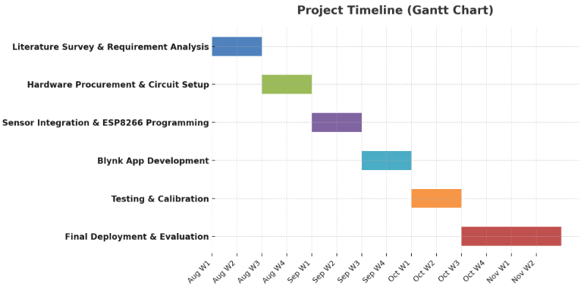
Timeline of the Project (Gantt Chart)

Slide 14
References
[1] J. Smith, “Deep learning in agricultural systems,” IEEE Transactions on Neural Networks and Learning Systems, vol. 32, no. 7, pp. 1234–1245, Jul. 2021.
[2] M. A. Hannan, M. J. Islam, M. Basri, H. Y. Choi, M. M. Rashid, and A. Hussain, “A smart irrigation system for precision agriculture using wireless sensor networks,” IEEE Internet of Things Journal, vol. 6, no. 2, pp. 2071–2081, Apr. 2019.
[3] A. S. El-Wakeel, M. A. Ramadan, and E. A. Mohamed, “IoT-based monitoring and control system for precision agriculture,” IEEE Access, vol. 8, pp. 125369–125379, Jul. 2020.

Slide 15


